Slide 1




Slide 2

Introduction
Mechanical & Electrical Contractors
Founded in 1994
Formally known as Allpipe Engineering
Strategically located in Maydown, N.Ireland
120+ employees

Slide 3
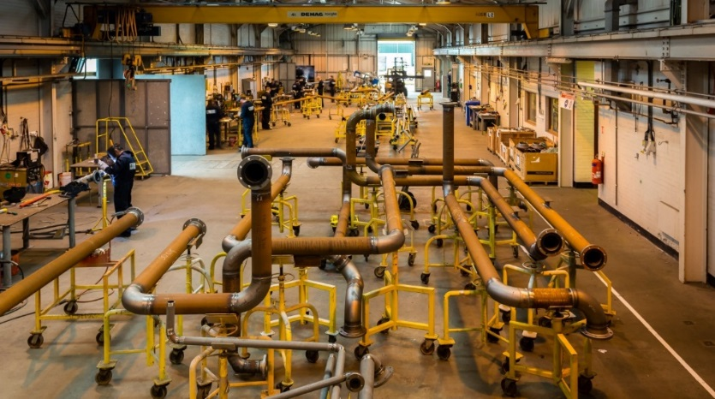
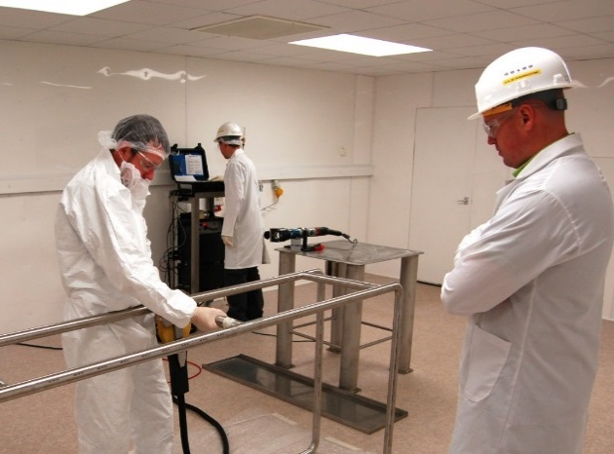
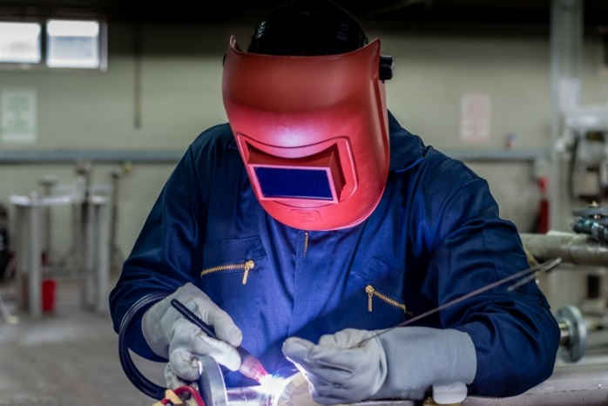
AEG Facilities
2400m² Carbon Steel Workshop
1500m² Stainless Steel Workshop
Cleanroom
X-ray facilities

Slide 4
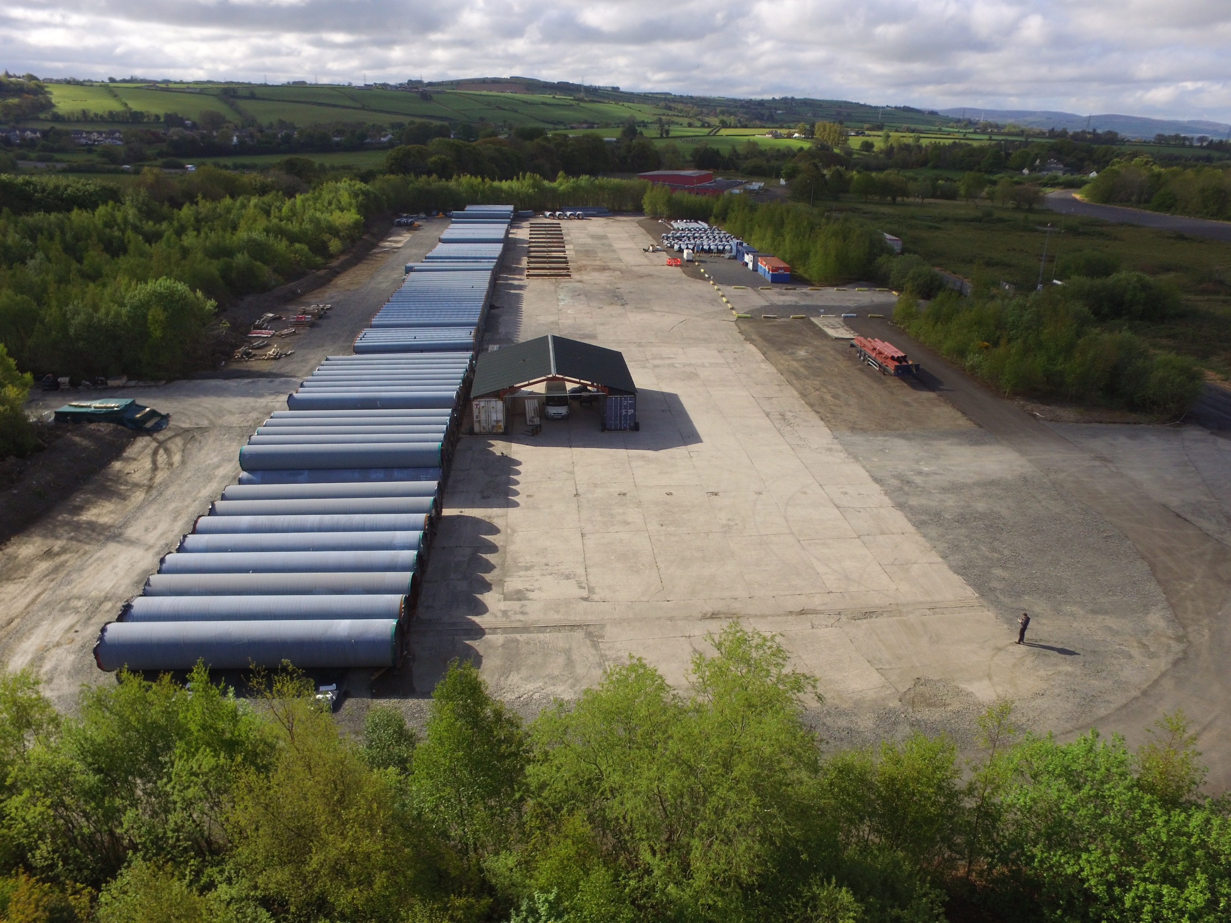
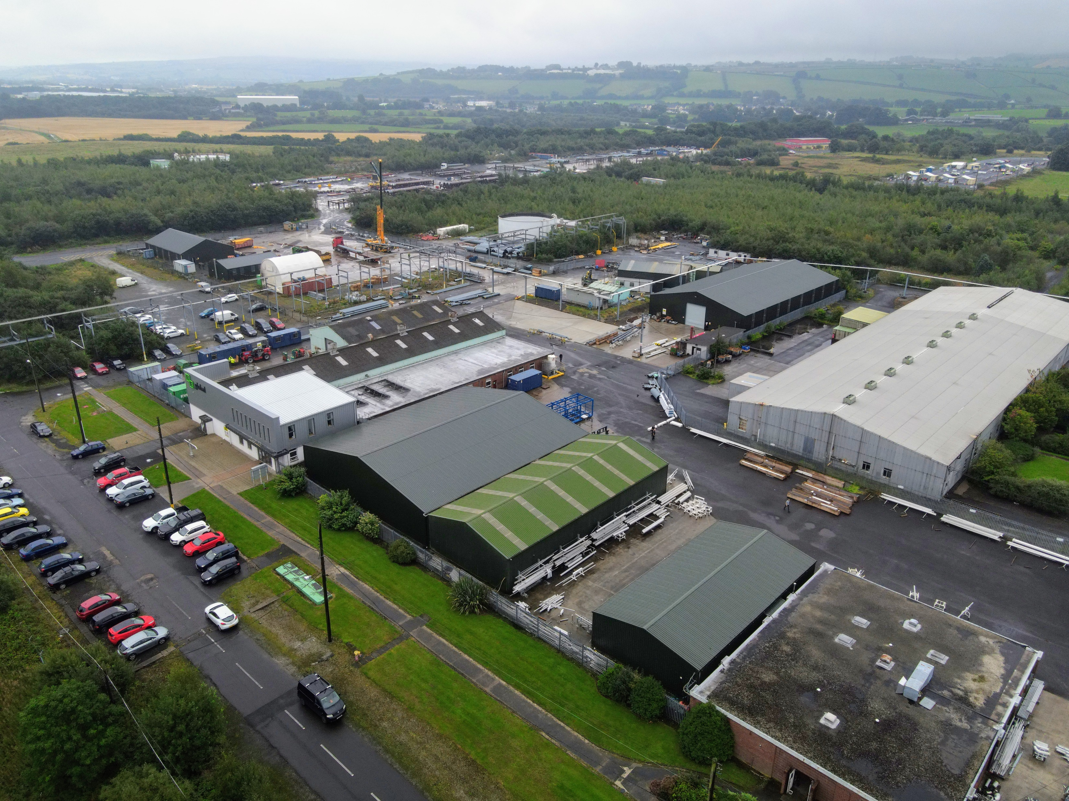
AEG Facilities

Slide 5
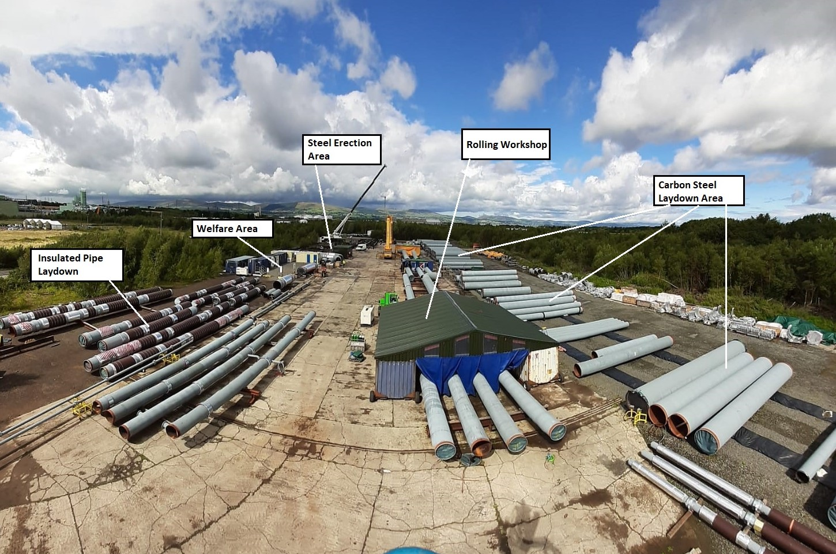
Modular Assembly Area
  Steel Erection and Inspection
  Pipe Fabrication, Testing, Flushing & Insulation.
  Pipe Assembly.
  Module Storage until site requirements.

Slide 6










Clients

Slide 7

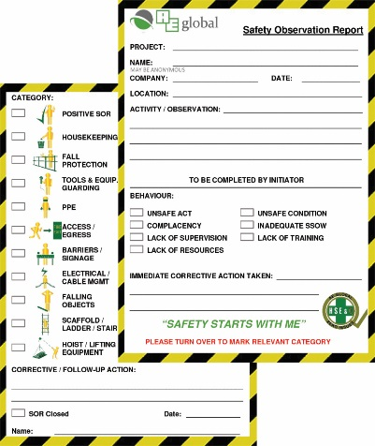
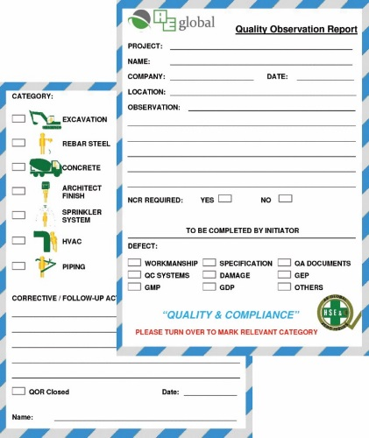
Safety & Quality
Management Systems
SOR Programme – Safety Observation Report
  Pro-active not reactive
QOR Programme – Quality Observation Report
  Seek quality in everything

Slide 8
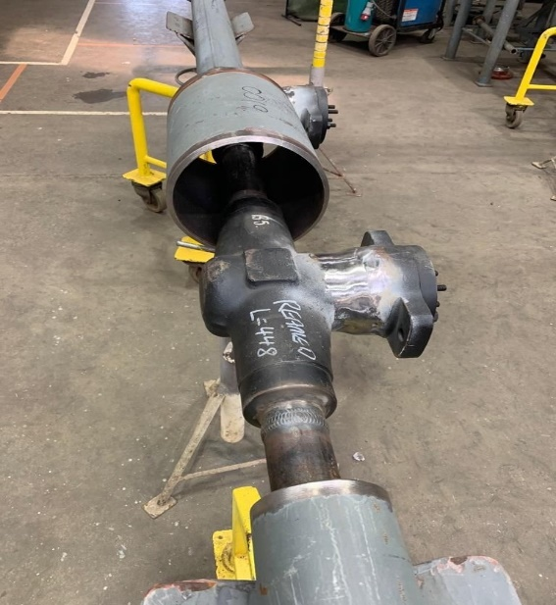
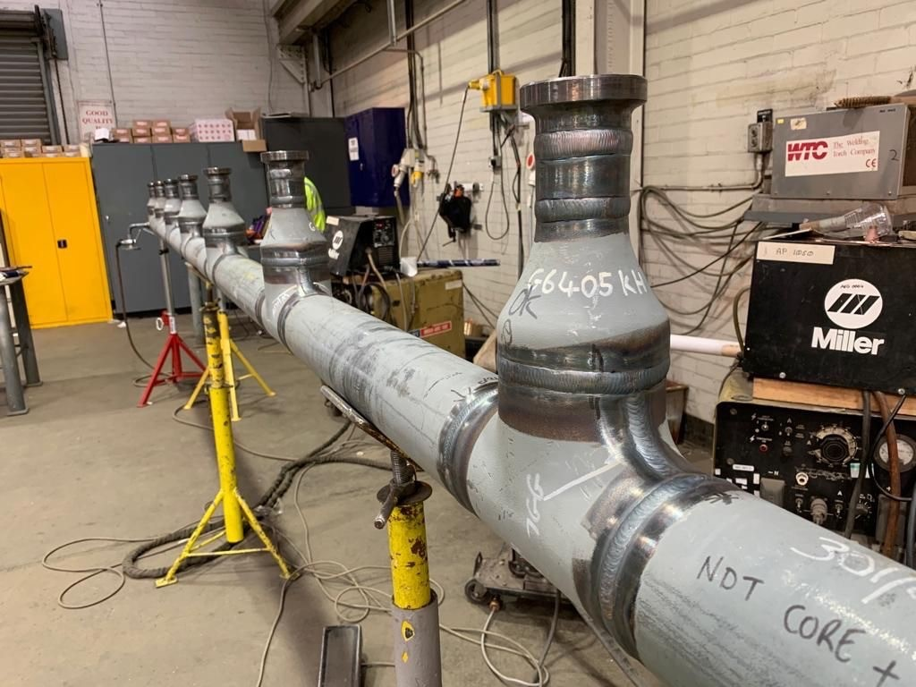
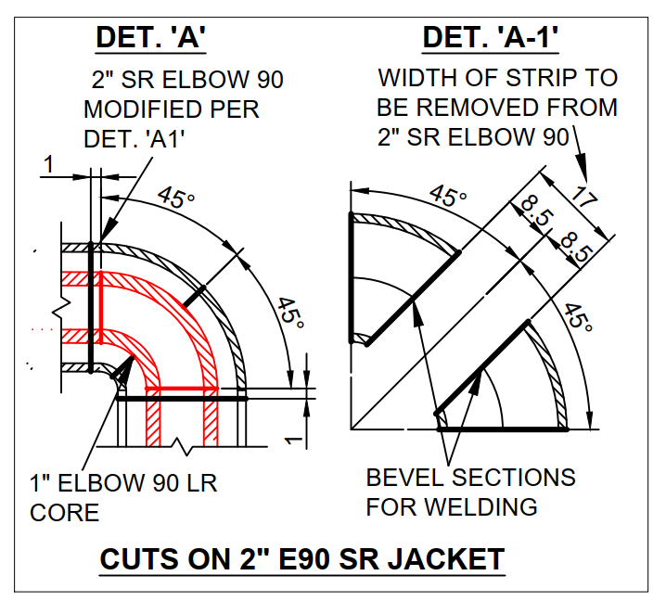
Previous Projects
Textiles Project - Luxembourg
  High Pressure Double-contained
  (Jacketed) Pipework
  Constructability design, fabrication

Slide 9
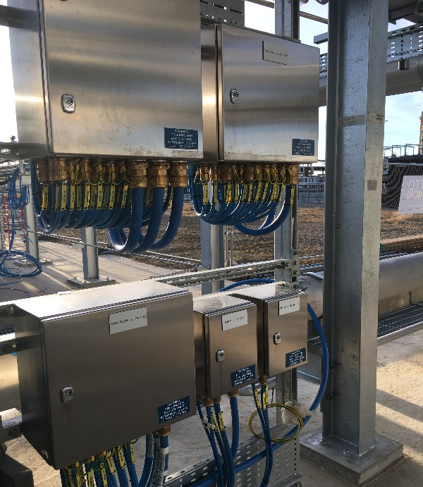
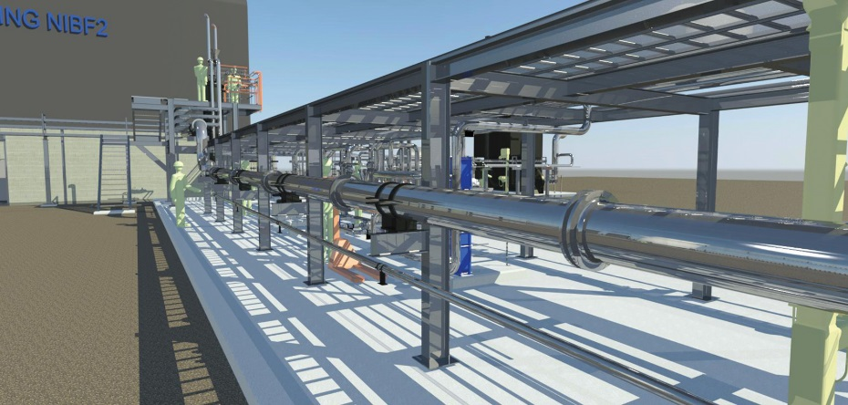
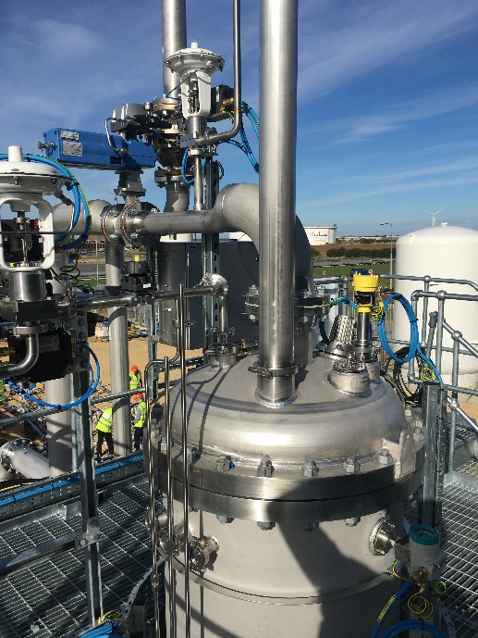
Previous Projects
Biotechnology Project – Teeside Middlesbrough
  Feasibility, detail design, 3D modelling
  Full Mechanical/Electrical & Installation

Slide 10
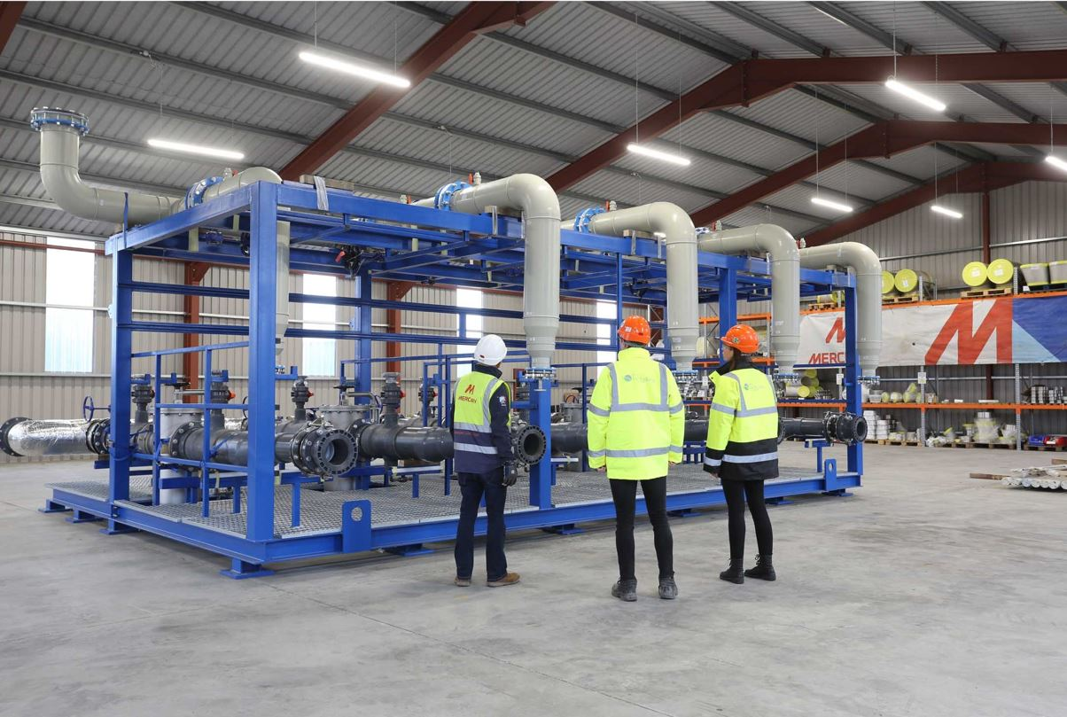
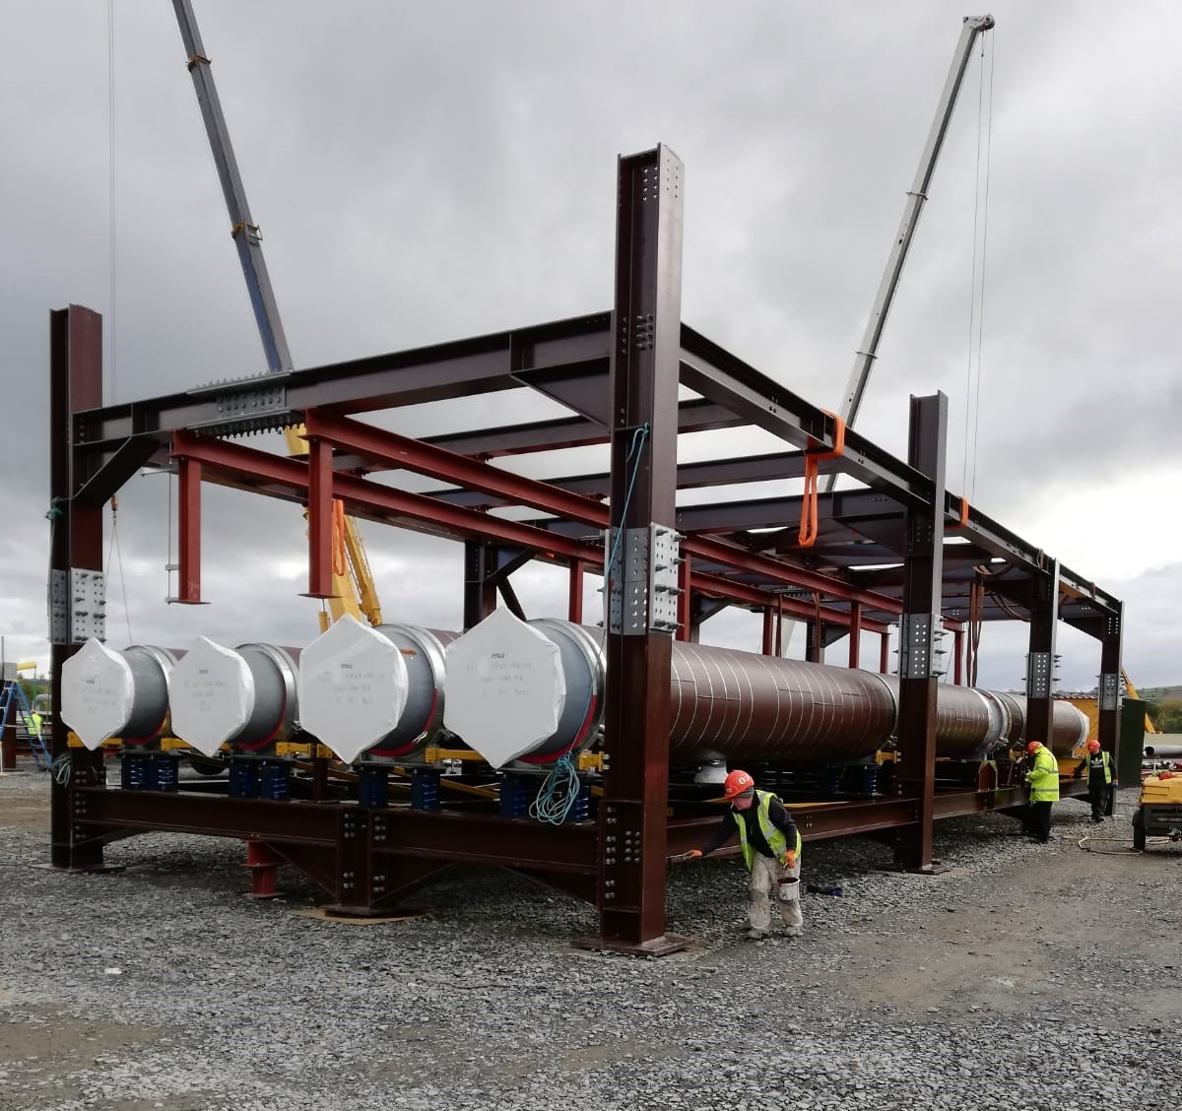
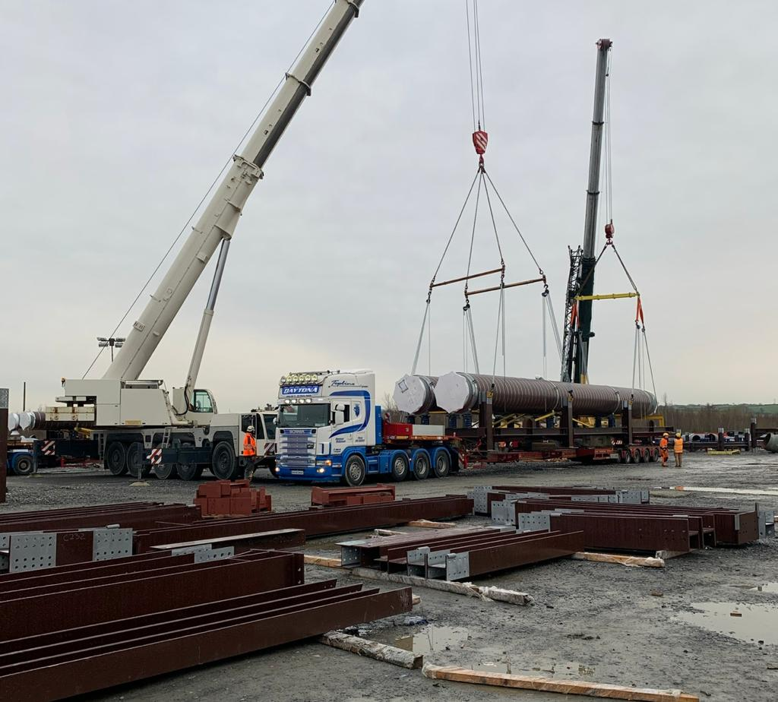
Previous Projects
Semi-conductor Facility – Dublin
  BIM Modelling & Piping design
  Off site modularisation & Fabrication

Slide 11
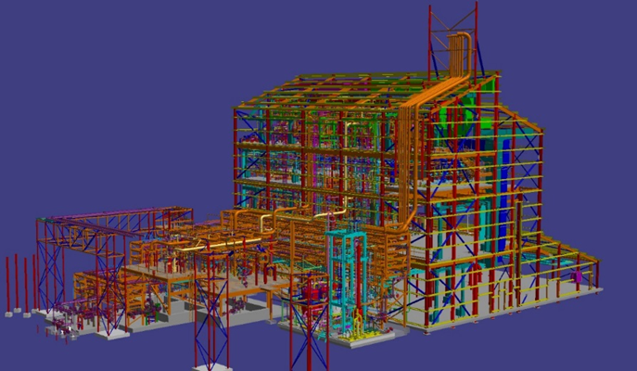
Previous Projects
Pharma Project - Scotland
  Constructability, Fabrication and installation of piping, plant and equipment
  Secondary steel, pipe support design fabrication and installation
  Tie-ins, Pre-commissioning.

Slide 12
Key Areas
Group Operations:
  Health & Safety
  Quality
  Accounts
  Digital Development
Electrical Engineering:
  Design
  Installation
  De-commissioning
  Hazardous Area Installations & Inspections

Slide 13
Key Areas
Office
  Building Information Modelling (BIM)
  Design
  Pipe Sketching
  Document Control
  Project management
Pipeshop
  Carbon/Stainless steel fabrication
  Pipefitting
  Coded welding
  Steel fabrication
  Modular Frames
Mechanical Engineering:

Slide 14
Roles & Approx. Salary Bands
Role | Typical AEG Salary Bands
Project Manager | £40k - £50k
Quantity Surveyor (Jnr/Snr) | £30k - £50k
Mechanical Engineer | £30k - £45k
BIM Modeler/Sketcher | £25k - £35k
HSE/QA Managers | £35k - £40k
Document Control/Admin | £25k - £35k
Supervisor (Mech. or Elect.) | £35k - £45k
Welder/Pipefitter | £30k - £38k
Fabricator | £30k - £35k
Electrician | £30k - £38k
Trainee | £12k - £24k

Slide 15
Website - https://www.aeglobal.uk
Email – careers@aeglobal.uk
Phone - 02871861020

